Slide 1
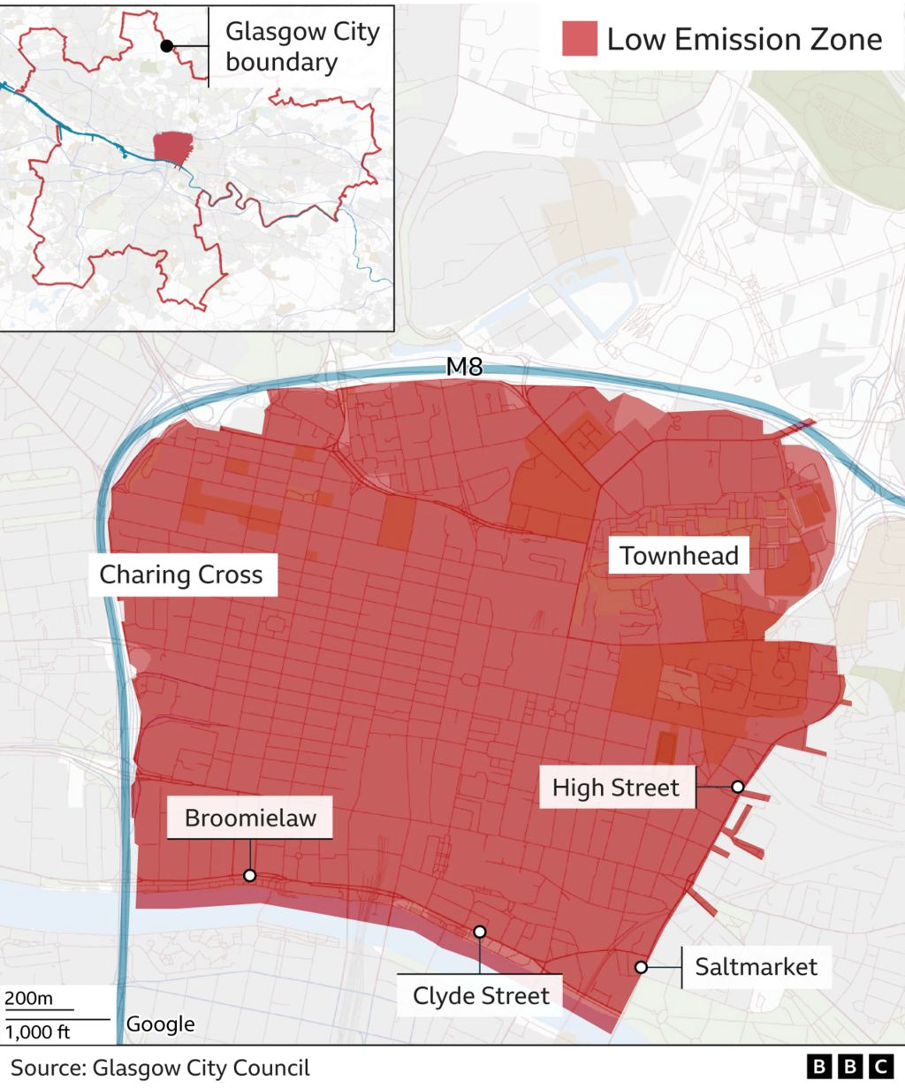
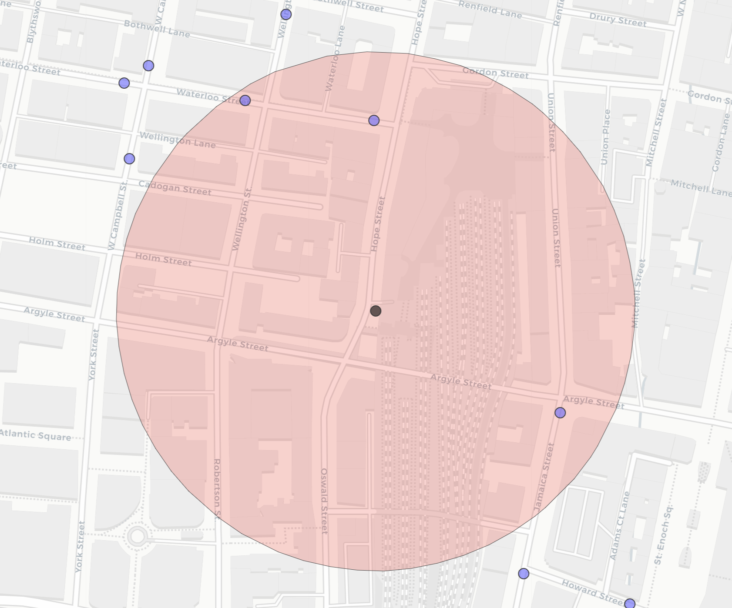
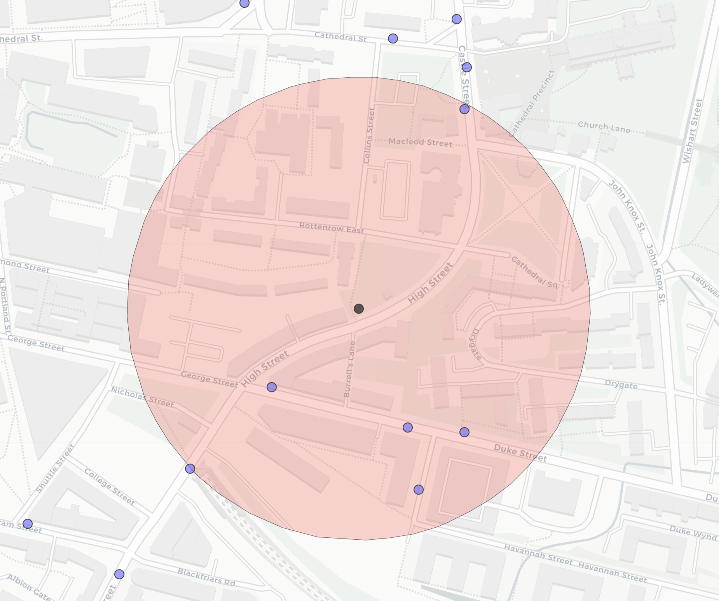


B
GA1571_Q: 146m
C
GA5371_C: 195m
A
GHSR
GHSR
GLA4
GA2401_D: 162m
GG2001_S: 101m
GLA4
Glasgow Hope St.
Glasgow High St.

Slide 2
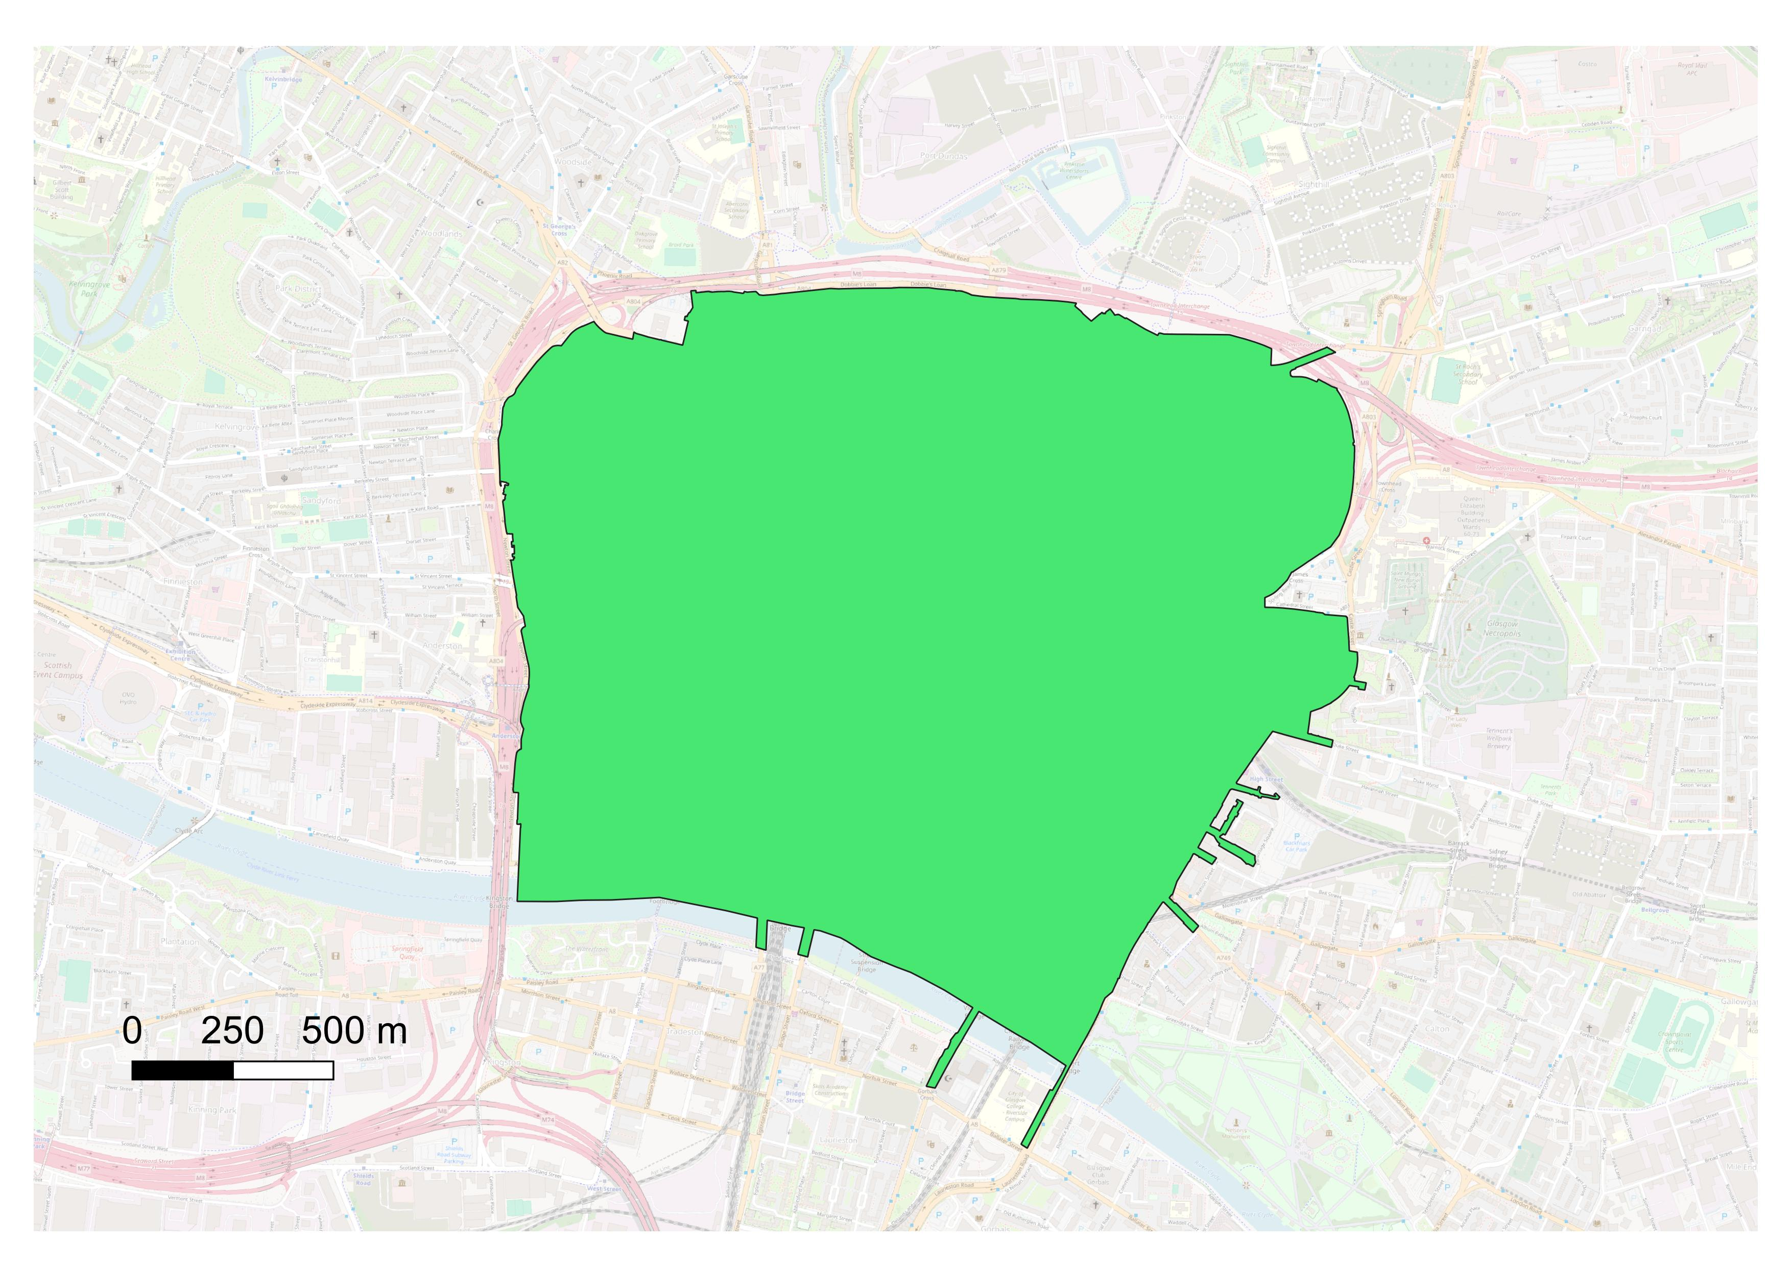
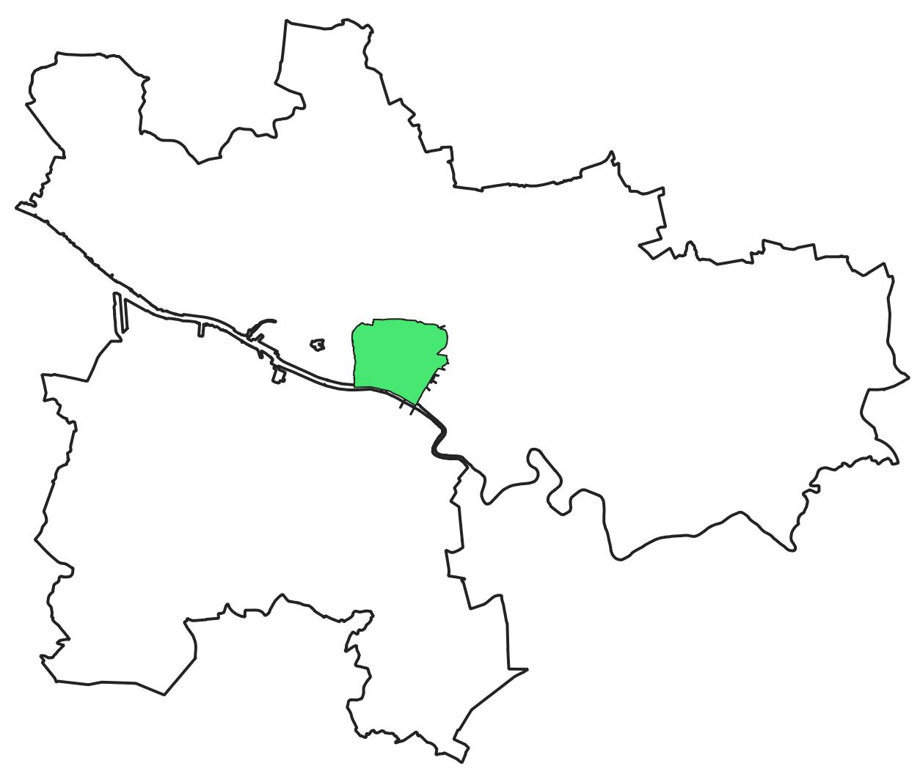

Slide 3
Glasgow City boundary
A
Glasgow Low Emission
Zone
GHSR
GLA4
B
GA1571_Q: 146m
C
GA5371_C: 195m
GHSR
GLA4
GA2401_D: 162m
GG2001_S: 101m
Glasgow Hope St.
Glasgow High St.

